Slide 1
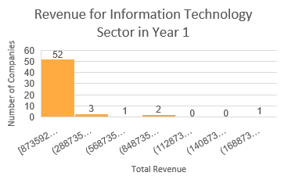
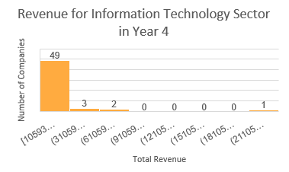
Does Revenue Defere for Information Technology Sector Between Year 1 and Year 4?
The total revenue in Unformation Technology sector increased from year 1 to year 4.
Mean revenue increased from 15.5 bilion in year 1 to 16 bilion in year 4.
In both years data is highly right skewed. That means that in both cases median is smaller than mean.
Range between minimal and maximal reported revenue increased from year 1 to year 4, and standard deviation increased as well. That mean that there is more variance in total revenue in year 4 then in year 1.

